Slide 1

Operant Conditioning: Case Study Thorndike Law of Effect 1989
ATPSY Year 12 ATAR Psychology

Slide 2

Review
Exam Questions:14 minutes

Slide 3
Learning Intentions
study: Law of effect (Thorndike, 1898)

Slide 4
Success Criteria
Summarise the procedure, findings, strengths and limitations of Thorndike’s cage experiments.
State The Law of Effect
Apply Operant Conditioning to Thorndike’s Experiment

Slide 5
Edward Thorndike (1898)
The Law of Effect:
“Responses that produce a satisfying effect in a particular situation become more likely to occur again in that situation, and responses that produce a discomforting effect become less likely to occur again in that situation”
What is another word for ‘satisfying effect’? ‘discomforting effect’?

Slide 6



VENN DIAGRAM
association occurs whether the stimulus is pleasurable or not.
reward leads to repetition while punishment leads to extinction.
strength of conditioning is measured by speed of response.
strength is measured by rate of behaviour.
extinction occurs if unconditioned stimulus is not paired with conditioned stimulus frequently enough
the response is a reflex
the response is involuntary.
the response is voluntary behaviour.
the stimulus is new to the animal.
the behaviour is new to the animal.
the response follows the stimulus.
the response precedes the reward or punishment.
CC
OC

Slide 7
Operant conditioning vs classical conditioning
Whereas classical conditioning depends on developing associations between events, operant conditioning involves learning from the consequences of our behaviour.

Slide 8
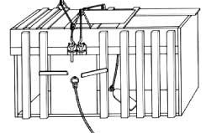
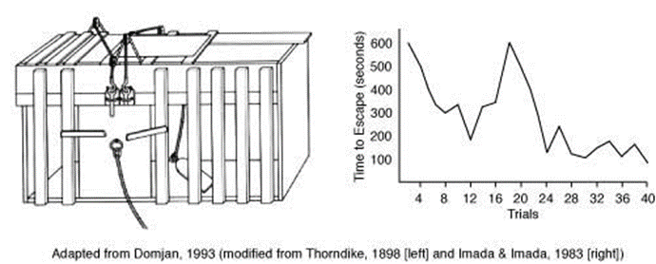
Thorndike studied learning in animals (usually cats). He devised a classic experiment in which he used a puzzle box to empirically test the laws of learning.
What do we mean by empirical testing?

Slide 9


Slide 10
Experimental Design
IV:
DV:
CV:
EV:
Findings:

Slide 11
Success Criteria
Summarise the procedure of Thorndike’s cage experiments.
State The Law of Effect
Apply Operant Conditioning to Thorndike’s Experiment
Compare classical conditioning to operant conditioning

